Slide 1
SQL Authorization
PRIVILEGES
GRANT AND REVOKE
GRANT DIAGRAMS
DATABASE SYSTEMS AND CONCEPTS, CSCI 3030U, UOIT, COURSE INSTRUCTOR: JAREK SZLICHTA

Slide 2
Authorization
A file system identifies certain privileges on the objects (files) it manages.
  Typically read, write, execute.
A file system identifies certain participants to whom privileges may be granted.
  Typically the owner, a group, all users.
DATABASE SYSTEMS AND CONCEPTS, CSCI 3030U, UOIT, COURSE INSTRUCTOR: JAREK SZLICHTA

Slide 3
Privileges – (1)
SQL identifies a more detailed set of privileges on objects (relations) than the typical file system.
Nine privileges in all, some of which can be restricted to one column of one relation.
DATABASE SYSTEMS AND CONCEPTS, CSCI 3030U, UOIT, COURSE INSTRUCTOR: JAREK SZLICHTA

Slide 4
Privileges – (2)
Some important privileges on a relation:
  SELECT = right to query the relation.
  INSERT = right to insert tuples.
    May apply to only one attribute.
  DELETE = right to delete tuples.
  UPDATE = right to update tuples.
    May apply to only one attribute.
DATABASE SYSTEMS AND CONCEPTS, CSCI 3030U, UOIT, COURSE INSTRUCTOR: JAREK SZLICHTA

Slide 5
Example: Privileges
For the statement below:
INSERT INTO Beers(name)
SELECT beer FROM Sells
WHERE NOT EXISTS
(SELECT * FROM Beers
WHERE name = beer);
We require privileges SELECT on Sells and Beers, and INSERT on Beers or Beers.name.
Beers appearing in
Sells that do
not appear in
Beers. We add
them to Beers
with a NULL
manufacturer.
DATABASE SYSTEMS AND CONCEPTS, CSCI 3030U, UOIT, COURSE INSTRUCTOR: JAREK SZLICHTA

Slide 6
Database Objects
The objects on which privileges exist including stored tables and views.
Other privileges are the right to create objects of a type, e.g., triggers.
Views form an important tool for access control.
DATABASE SYSTEMS AND CONCEPTS, CSCI 3030U, UOIT, COURSE INSTRUCTOR: JAREK SZLICHTA
Notes:
What is view?

Slide 7
Example: Views as Access Control
We might not want to give the SELECT privilege on Emps(name, addr, salary).
But it is safer to give SELECT on:
CREATE VIEW SafeEmps AS
SELECT name, addr FROM Emps;
Queries on SafeEmps do not require SELECT on Emps, just on SafeEmps.
DATABASE SYSTEMS AND CONCEPTS, CSCI 3030U, UOIT, COURSE INSTRUCTOR: JAREK SZLICHTA
Notes:
Is it materialized or virtual view?

Slide 8
Authorization ID’s
A user is referred to by authorization ID, typically their login name.
There is an authorization ID PUBLIC.
  Granting a privilege to PUBLIC makes it available to any authorization ID.
DATABASE SYSTEMS AND CONCEPTS, CSCI 3030U, UOIT, COURSE INSTRUCTOR: JAREK SZLICHTA

Slide 9
Granting Privileges
You have all possible privileges on the objects, such as relations, that you create.
You may grant privileges to other users (authorization ID’s), including PUBLIC.
You may also grant privileges WITH GRANT OPTION, which lets the grantee also grant this privilege.
DATABASE SYSTEMS AND CONCEPTS, CSCI 3030U, UOIT, COURSE INSTRUCTOR: JAREK SZLICHTA

Slide 10
The GRANT Statement
To grant privileges, say:
GRANT <list of privileges>
ON <relation or other object>
TO <list of authorization ID’s>;
If you want the recipient(s) to be able to pass the privilege(s) to others add:
WITH GRANT OPTION
DATABASE SYSTEMS AND CONCEPTS, CSCI 3030U, UOIT, COURSE INSTRUCTOR: JAREK SZLICHTA

Slide 11
Example: GRANT
Suppose you are the owner of Sells. You may say:
GRANT SELECT, UPDATE(price)
ON Sells
TO sally;
Now Sally has the right to issue any query on Sells and can update the price component only.
DATABASE SYSTEMS AND CONCEPTS, CSCI 3030U, UOIT, COURSE INSTRUCTOR: JAREK SZLICHTA
Notes:
http://www.postgresql.org/docs/9.0/static/sql-grant.html
Can Sally give grant to Sells?

Slide 12
Example: Grant Option
Suppose we also grant:
GRANT UPDATE ON Sells TO sally
WITH GRANT OPTION;
Now, Sally not only can update any attribute of Sells, but can grant to others the privilege UPDATE ON Sells.
  Also, she can grant more specific privileges like UPDATE(price)ON Sells.
DATABASE SYSTEMS AND CONCEPTS, CSCI 3030U, UOIT, COURSE INSTRUCTOR: JAREK SZLICHTA

Slide 13
Task
Assume for simplicity there is a table Movies(movieID, movie, gross, type), owned by you.
Write SQL statement(s) using view giving access (SELECT) to John to columns movieID, movie and movie type only, such that:
  John can pass grant privilegas to other users
  John cannot pass privileges to other user
DATABASE SYSTEMS AND CONCEPTS, CSCI 3030U, UOIT, COURSE INSTRUCTOR: JAREK SZLICHTA

Slide 14
Revoking Privileges
REVOKE <list of privileges>
ON <relation or other object>
FROM <list of authorization ID’s>;
Your grant of these privileges can no longer be used by these users to justify their use of the privilege.
  But they may still have the privilege because they obtained it independently from elsewhere.
DATABASE SYSTEMS AND CONCEPTS, CSCI 3030U, UOIT, COURSE INSTRUCTOR: JAREK SZLICHTA

Slide 15
REVOKE Options
We must append to the REVOKE statement either:
  CASCADE. Now, any grants made by a revokee are also not in force, no matter how far the privilege was passed.
  RESTRICT. If the privilege has been passed to others, the REVOKE fails as a warning that something else must be done to “chase the privilege down.”
DATABASE SYSTEMS AND CONCEPTS, CSCI 3030U, UOIT, COURSE INSTRUCTOR: JAREK SZLICHTA

Slide 16
Grant Diagrams
Nodes = user/privilege/grant option?/is owner?
  UPDATE ON R, UPDATE(a) on R, and UPDATE(b) ON R live in different nodes.
  SELECT ON R and SELECT ON R WITH GRANT OPTION live in different nodes.
Edge X ->Y means that node X was used to grant Y.
DATABASE SYSTEMS AND CONCEPTS, CSCI 3030U, UOIT, COURSE INSTRUCTOR: JAREK SZLICHTA

Slide 17
Notation for Nodes
Use AP for the node representing authorization ID A having privilege P.
  P * = privilege P with grant option.
  P ** = the source of the privilege P.
    I.e., A is the owner of the object on which P is a privilege.
    Note ** implies grant option.
DATABASE SYSTEMS AND CONCEPTS, CSCI 3030U, UOIT, COURSE INSTRUCTOR: JAREK SZLICHTA

Slide 18
Manipulating Edges – (1)
When A grants P to B, we draw an edge from AP * or AP ** to BP.
  Or to BP * if the grant is with grant option.
If A grants a subprivilege Q of P [say UPDATE(a) on R when P is UPDATE ON R] then the edge goes to BQ or BQ *, instead.
DATABASE SYSTEMS AND CONCEPTS, CSCI 3030U, UOIT, COURSE INSTRUCTOR: JAREK SZLICHTA

Slide 19
Manipulating Edges – (2)
Fundamental rule: User C has privilege Q as long as there is a path from XP ** to CQ, CQ *, or CQ **, and P is a superprivilege of Q.
  Remember that P could be Q, and X could be C.
DATABASE SYSTEMS AND CONCEPTS, CSCI 3030U, UOIT, COURSE INSTRUCTOR: JAREK SZLICHTA

Slide 20
Manipulating Edges – (3)
If A revokes P from B with the CASCADE option, delete the edge from AP to BP.
But if A uses RESTRICT instead, and there is an edge from BP to anywhere, then reject the revocation and make no change to the graph.
DATABASE SYSTEMS AND CONCEPTS, CSCI 3030U, UOIT, COURSE INSTRUCTOR: JAREK SZLICHTA

Slide 21
Manipulating Edges – (4)
Having revised the edges, we must check that each node has a path from some ** node, representing ownership.
Any node with no such path represents a revoked privilege and is deleted from the diagram.
DATABASE SYSTEMS AND CONCEPTS, CSCI 3030U, UOIT, COURSE INSTRUCTOR: JAREK SZLICHTA

Slide 22
Example: Grant Diagram
B: GRANT P
TO C WITH
GRANT OPTION
AP**
BP*
CP*
A owns the
object on
which P is
a privilege
A: GRANT P
TO B WITH
GRANT OPTION
CP
A: GRANT P
TO C
DATABASE SYSTEMS AND CONCEPTS, CSCI 3030U, UOIT, COURSE INSTRUCTOR: JAREK SZLICHTA

Slide 23
Example: Grant Diagram
A executes
REVOKE P FROM B CASCADE;
Even had
C passed P
to B, both
nodes are
still cut off.
AP**
BP*
CP*
CP
Not only does B lose
P*, but C loses P*.
Delete BP* and CP*.
However, C still
has P without grant
option because of
the direct grant.
DATABASE SYSTEMS AND CONCEPTS, CSCI 3030U, UOIT, COURSE INSTRUCTOR: JAREK SZLICHTA

Slide 24
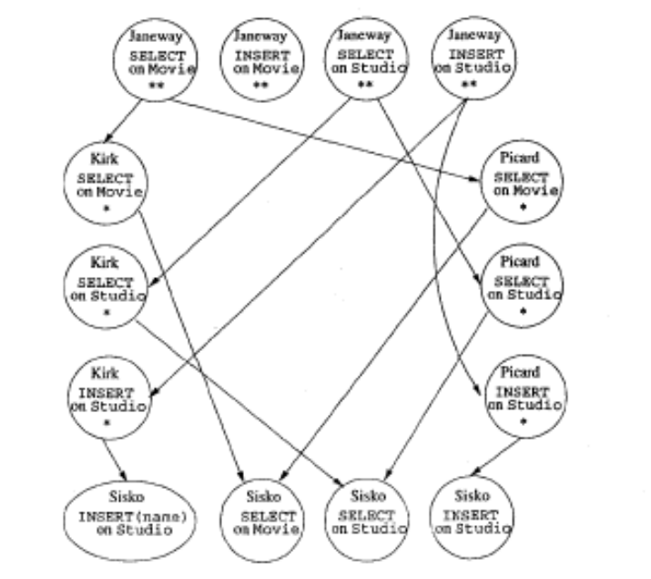
Task
Using Word, Google Slides, Powepoint, Visio or other software create a Grant Diagram for Movie Database (from course Project) with multiple users. Extra BONUS 1 point for the lab project!
DATABASE SYSTEMS AND CONCEPTS, CSCI 3030U, UOIT, COURSE INSTRUCTOR: JAREK SZLICHTA

Slide 25
Actions
Review slides!
Read Chapter 10.1: Security and User Administration in SQL
Optional: play with your movie (copy) or other databases (assign privileges):
  http://www.postgresql.org/docs/9.0/static/sql-grant.html
  http://www.postgresql.org/docs/9.0/static/sql-createuser.html
DATABASE SYSTEMS AND CONCEPTS, CSCI 3030U, UOIT, COURSE INSTRUCTOR: JAREK SZLICHTA

